Slide 1

Beware of Credit Card Fraud!

Slide 2
Credit card fraud can happen to anyone, and this can cause more harm with a Vishing attack
Vishing is a method of using the phone to get people to give out personal information
Be Careful Who you talk to on the phone especially if you don’t know who they are

Slide 3
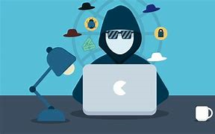
Today I am going to use a credit card number I stole from the gas pump
I think it would make for a nice family vacation

Slide 4
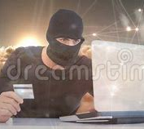

Now to make my illegal purchase Six Flags seems good right about now

Slide 5
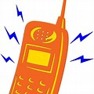
Meanwhile….

Slide 6
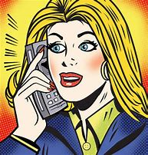
Why NO! Let me check my account
Hello this Visa credit
Did you make a purchase today?

Slide 7
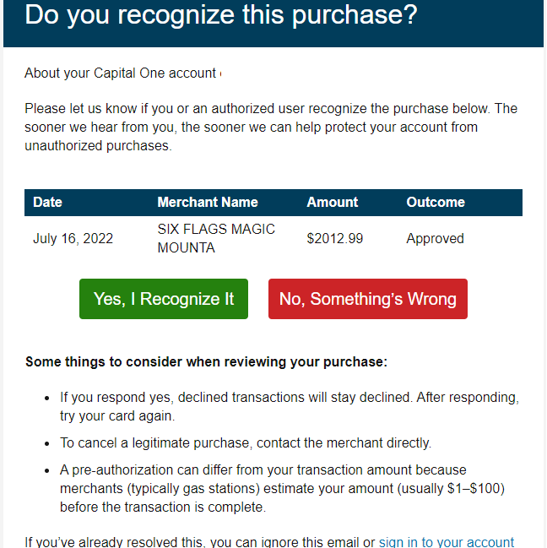
That’s over 2000.00 dollars! No I did not make the purchase.

Slide 8

We will cancel the transaction immediately
Thank you So Much!

Slide 9
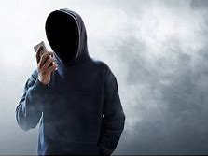
What a cancelled card! We’ll see about that
Hi I see you made a purchase at Six Flags. Did you make the purchase.
No thanks, but I have already handled it with my bank

Slide 10
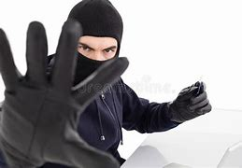
Darn! All this work for nothing!

Slide 11
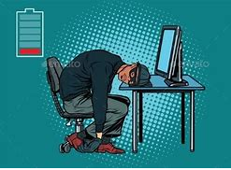
Aaaggh!!

Slide 12
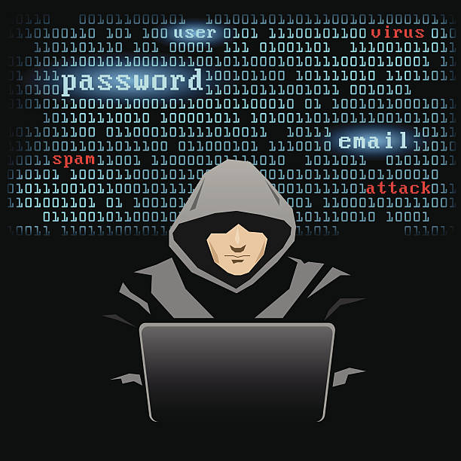
No worries I’ll just move on to the next one. Ha! Ha! Ha!

Slide 13
In Conclusion
Don’t give out information to a stranger on the cell phone.
Always log in to your account directly on your own link. Do not click any links on an unknown message
Try to use a credit card for your purchases. And only deal with disputes or fraud directly with your credit card company

